Slide 1


Deep Learning for High-Frequency Crypto Limit Order Book Forecasting
A Review, Empirical Evaluation, and Industry Context
Bhavya Jeevani Thandu | BA-64061-001 - Advanced Machine Learning

Slide 2
Abstract
This research reviews and evaluates deep learning models for predicting short-horizon price movements from high-frequency limit order book (LOB) data. We compare CNN, LSTM, Transformer, TCN, and a hybrid CNN+LSTM architecture on a large cryptocurrency LOB dataset.
The hybrid CNN+LSTM model demonstrated the best realistic performance.
The Temporal Convolutional Network (TCN) achieved near-perfect scores, but showed strong evidence of data leakage, making its results non-generalizable.
SHAP-based interpretability analysis was used to identify the microstructural drivers behind model predictions.
Findings are contextualized within broader industry applications of deep learning.

Slide 3
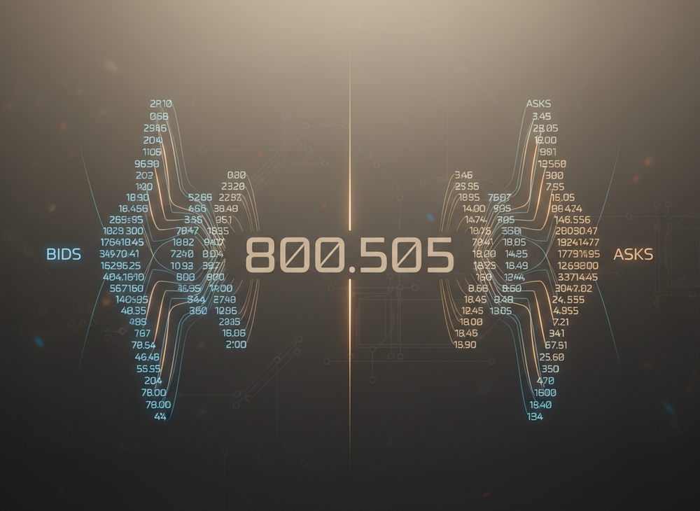
Introduction: The Challenge of LOB Data
The Data
The Problem
Limit Order Books (LOB) generate massive datasets containing rich information on market supply-demand imbalances, liquidity, and price pressure.
Traditional econometric and machine learning models struggle with the high dimensionality, non-stationarity, and nonlinearity of LOB data. Deep learning, particularly sequence-based models, has emerged as a state-of-the-art solution.

Slide 4
Research Objectives
This paper addresses four primary objectives in the application of deep learning to high-frequency LOB forecasting.
Identify and describe state-of-the-art deep learning models for LOB forecasting.
Provide a literature review of the latest techniques, their effectiveness, and limitations.
Discuss broader industry applications of deep learning beyond finance.
Present and analyze empirical results from five deep learning models, discussing future developments.

Slide 5
Deep Learning Architectures Evaluated
1
CNN (Convolutional Neural Network)
2
LSTM (Long Short-Term Memory)
3
Transformer
Uses a multi-head self-attention mechanism to model long-range dependencies directly, but often requires very large datasets.
Applies temporal convolutions to learn local, short-term features like changes in depth and spread. Often struggles with long-term dependencies.
A type of recurrent neural network (RNN) designed to capture longer-term dependencies and model sequential order flow.
4
TCN (Temporal Convolutional Network)
5
Hybrid CNN+LSTM
Combines CNNs for spatial feature extraction with LSTMs for temporal modeling. Often reported as state-of-the-art for LOB benchmarks.
Built with dilated causal convolutions, designed to outperform standard RNNs on sequence modeling tasks with stable gradients.

Slide 6
Methodology
Dataset & Preprocessing
Models & Evaluation
High-frequency cryptocurrency LOB data (BTC, ETH, etc.).
Five models implemented in PyTorch.
Trained for 10 epochs using Adam optimizer and cross-entropy loss.
Features engineered from a 100-timestep sliding window.
Evaluated using Accuracy, F1-Score, Confusion Matrices, and SHAP analysis.
Labels: Mid-price movement classified as {down, neutral, up}.
Data is split chronologically to prevent look-ahead bias.

Slide 7
Overall Performance Summary
MODEL
ACCURACY
F1
ECE
STABILITY
MISCLASSIFICATIONS
CNN
0.0000
0.0000
0.5348
0.0000
74,984
LSTM
0.3027
0.2323
0.2041
0.0199
52,289
TRANSFORMER
0.1286
0.1140
0.4989
0.0119
65,339
TCN
1.0
1.0
0.4423
0.0
0
CNN+LSTM
0.9605
0.4899
0.4572
0.0016
2,961
The CNN+LSTM hybrid model achieves the highest realistic accuracy at 96.05%. The TCN's perfect score is a strong indicator of data leakage, rendering its performance metrics invalid for real-world application.

Slide 8
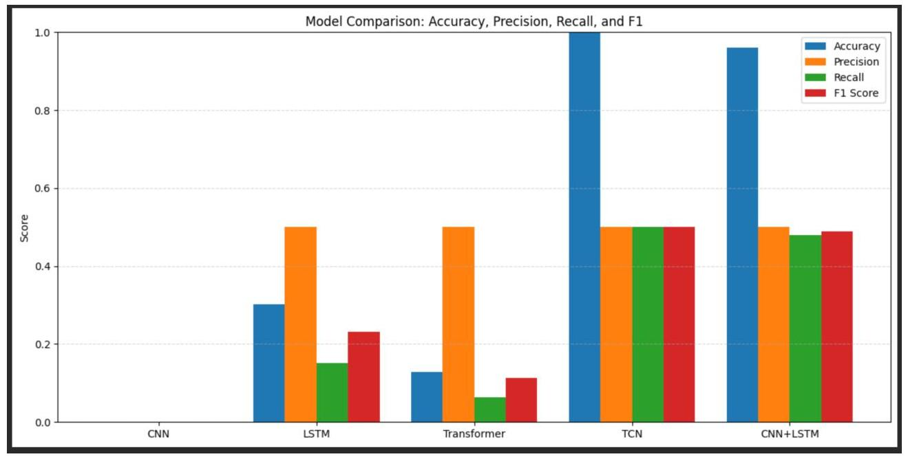
Comparative Model Performance
Key Observations
CNN, LSTM, and Transformer models show poor performance across all metrics.
The TCN model achieves a perfect score (1.0) on all metrics, which is a clear artifact of data leakage.
The CNN+LSTM model demonstrates strong, balanced performance, outperforming other non-leaky architectures significantly.

Slide 9
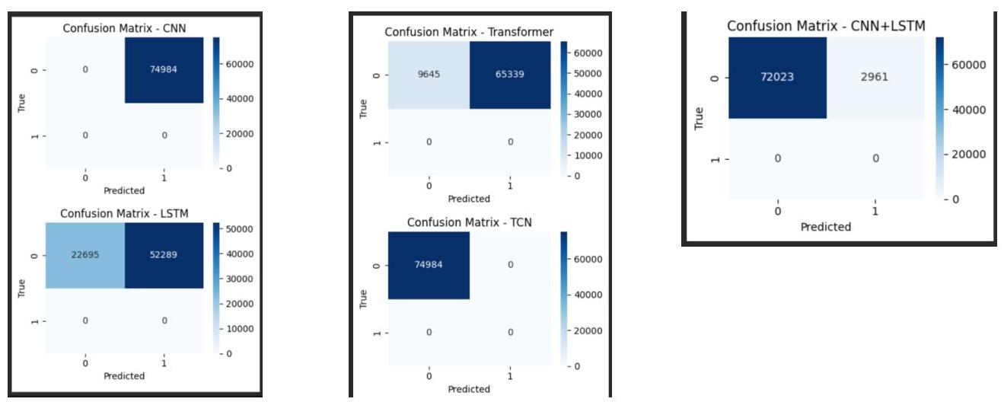
Confusion Matrix Analysis
Prediction Behavior
CNN: Fails, predicting only one class.
LSTM & Transformer: Suffer from severe misclassification, skewed towards the majority class.
TCN: A perfect diagonal matrix, confirming data leakage.
CNN+LSTM: Exhibits strong diagonal dominance, confirming it as the only robust and effective model.

Slide 10
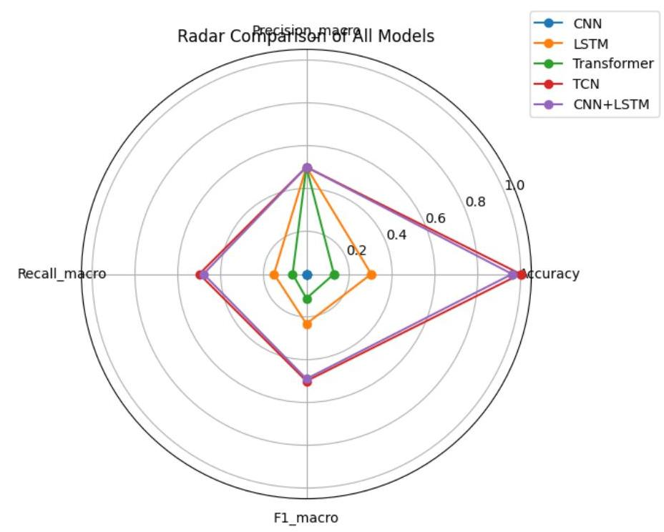
Radar Chart Summary
Holistic Performance View
CNN & LSTM: Collapse near the center, indicating poor performance on all fronts.
Transformer: Shows an irregular, thin shape, reflecting unstable and ungeneralizable learning.
TCN: Forms a perfect square at the outer edge, a clear visual of its unrealistic, leakage-driven results.
CNN+LSTM: Produces the largest and most balanced polygon among realistic models, demonstrating consistent strength across accuracy, precision, recall, and F1-score.

Slide 11
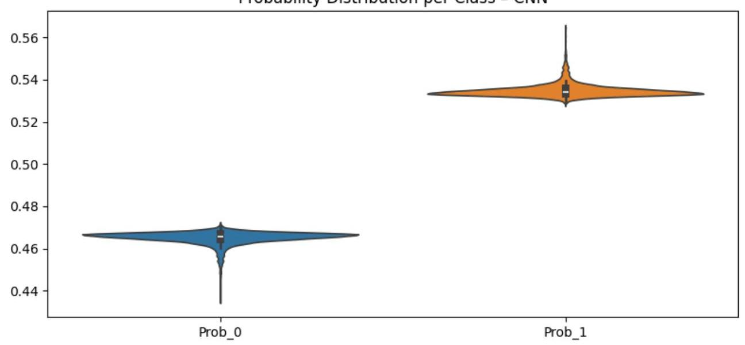
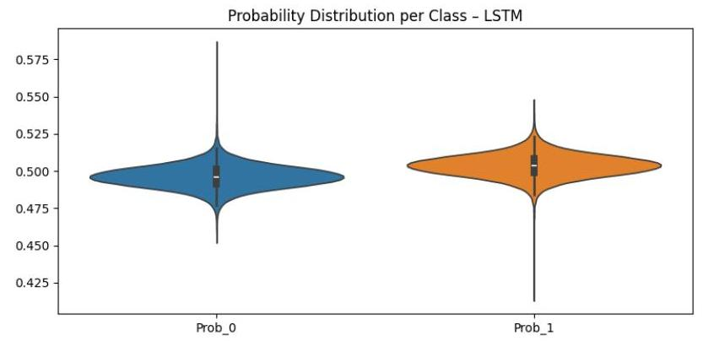
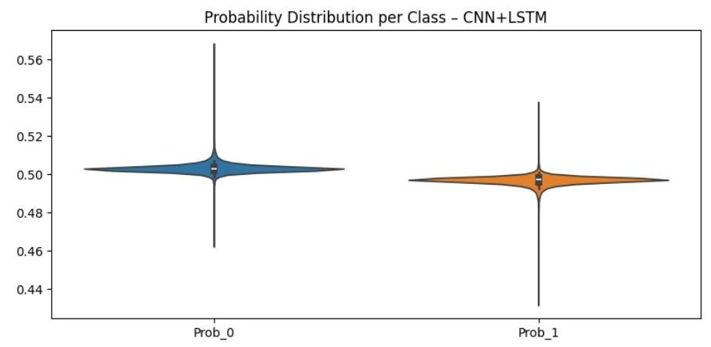
Model Confidence: Probability Distributions
Violin plots of predicted probabilities reveal model confidence and class separation ability.
CNN: No Separation
LSTM: Weak Separation
CNN+LSTM: Well-Calibrated
The weak models (CNN, LSTM) show overlapping distributions centered around 0.5, indicating an inability to distinguish between classes. The CNN+LSTM model, however, shows tight, stable distributions, reflecting well-calibrated and confident predictions.

Slide 12
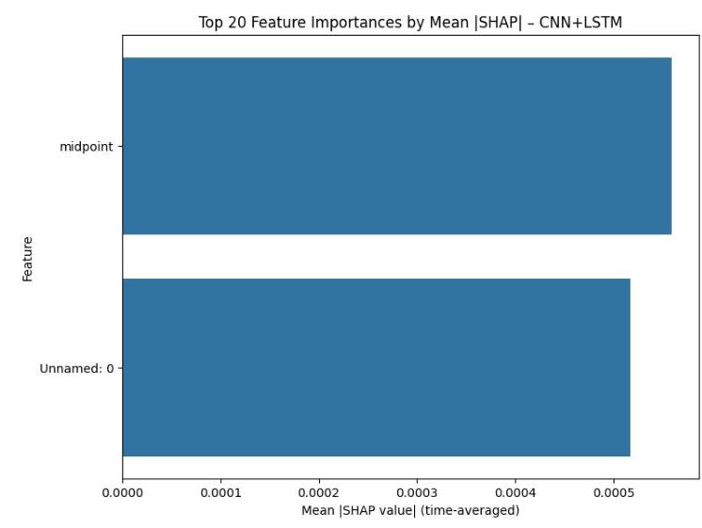
Feature Importance: What are the Models Learning?
SHAP Analysis
CNN+LSTM Feature Importance
SHAP (SHapley Additive exPlanations) analysis was used to determine which input features were most influential for each model's predictions. The goal is to verify that models rely on meaningful LOB microstructure features.
Most underperforming models (CNN, LSTM, TCN) focused on just one or two features, such as 'midpoint', indicating that they failed to learn complex relationships from the book's depth.
The CNN+LSTM model displays a more balanced and smooth feature importance pattern, consistent with its well-calibrated output and high performance. It effectively utilizes a wider range of microstructure signals.

Slide 13
Broader Industry Applications
The deep learning architectures evaluated are foundational across many industries, demonstrating their versatility.
Healthcare
Transportation
Cybersecurity
CNNs and Transformers are used for radiological image classification (e.g., cancer detection) and predicting disease trajectories from patient data.
In autonomous driving, CNNs, LSTMs, and Transformers play a crucial role in perception, sensor fusion, and real-time trajectory prediction.
Recurrent networks and hybrid models are used in intrusion detection systems (DL-IDS) to identify anomalous patterns in network traffic.

Slide 14
Limitations and Future Directions
Limitations
Future Research
Data Leakage: A critical risk in financial forecasting, as seen with the TCN. Requires rigorous, standardized evaluation pipelines.
Reinforcement Learning (RL): Integrating predictive models with RL agents to create end-to-end trading systems that optimize execution.
Interpretability: 'Black box' models are a challenge in regulated industries. Methods like SHAP are a start, but have limitations for complex sequence models.
Domain-Specific Transformers: Designing architectures or pre-training methods specifically for LOB dynamics.
Robustness: Performance can degrade during market regime shifts (e.g., flash crashes). Models need to be more adaptable.
Regime-Aware Models: Incorporating adversarial training or regime detection layers to improve robustness.

Slide 15
Conclusion
This study confirms that well-structured deep learning methods, particularly hybrid architectures, offer significant promise for high-frequency financial forecasting.
The hybrid CNN+LSTM model demonstrated superior, robust, and interpretable performance in predicting LOB mid-price movements.
The failure of the TCN due to data leakage serves as a critical cautionary tale, emphasizing the need for rigorous validation.
While challenges in interpretability and robustness remain, the potential for further research in specialized transformers and reinforcement learning is vast.
Deep learning is a powerful tool for modeling complex market microstructure, with ample opportunity to enhance model scalability, robustness, and practicality.

